Slide 1
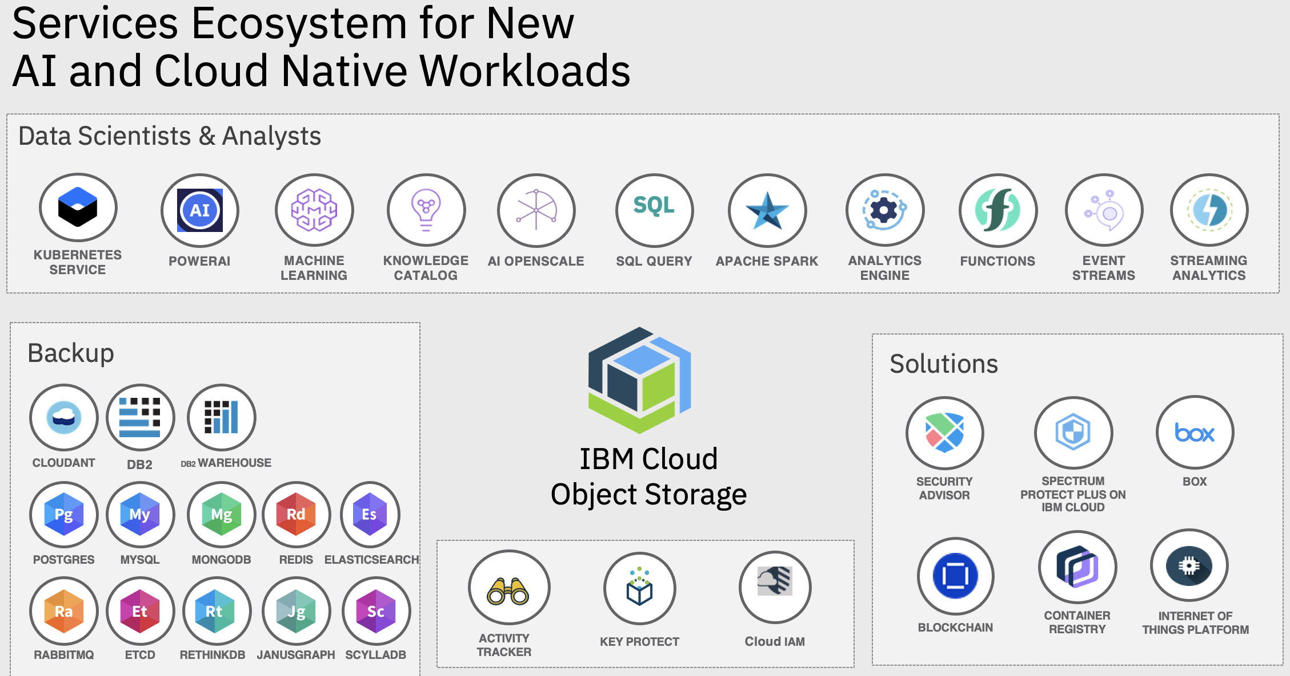
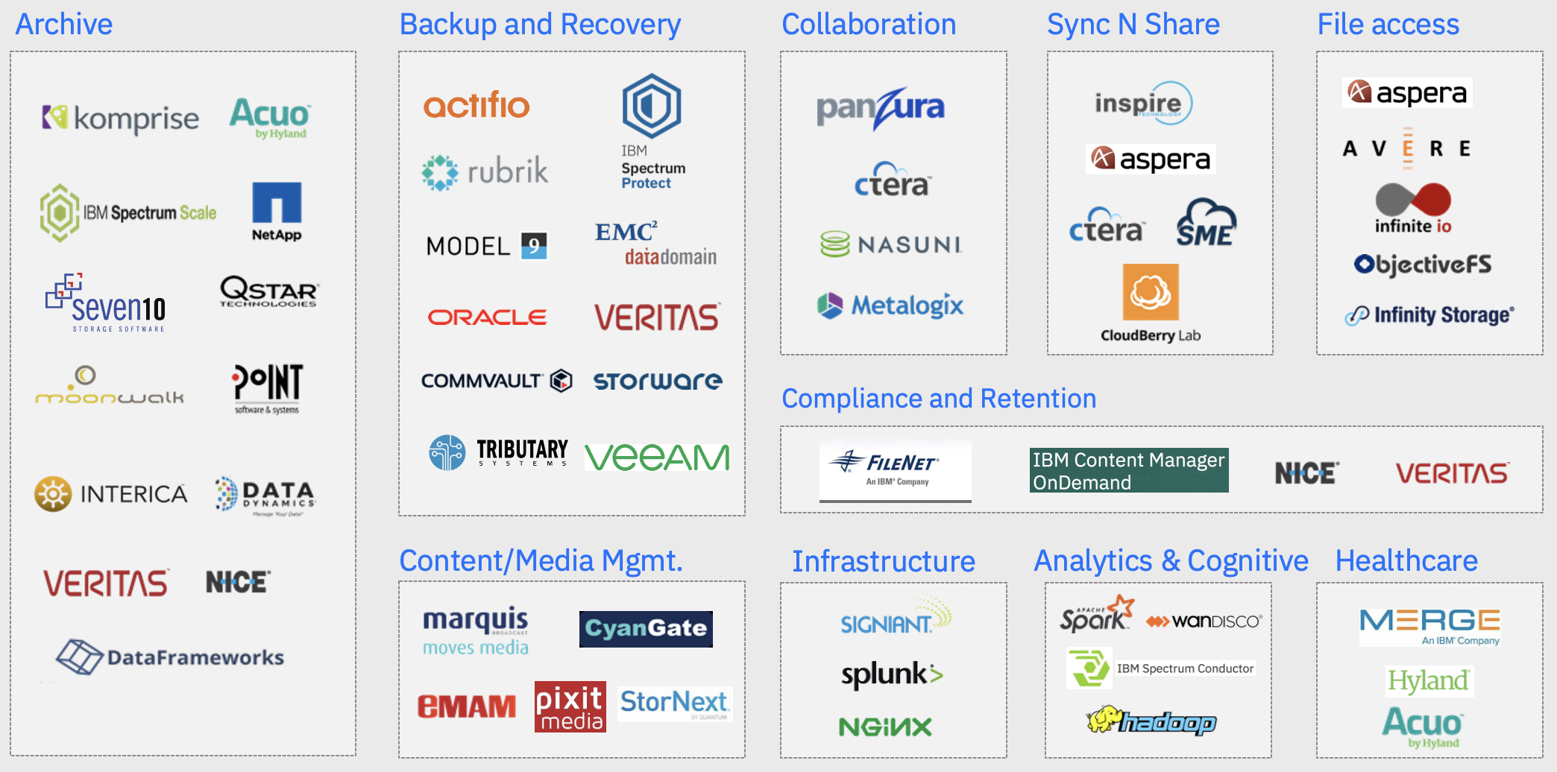
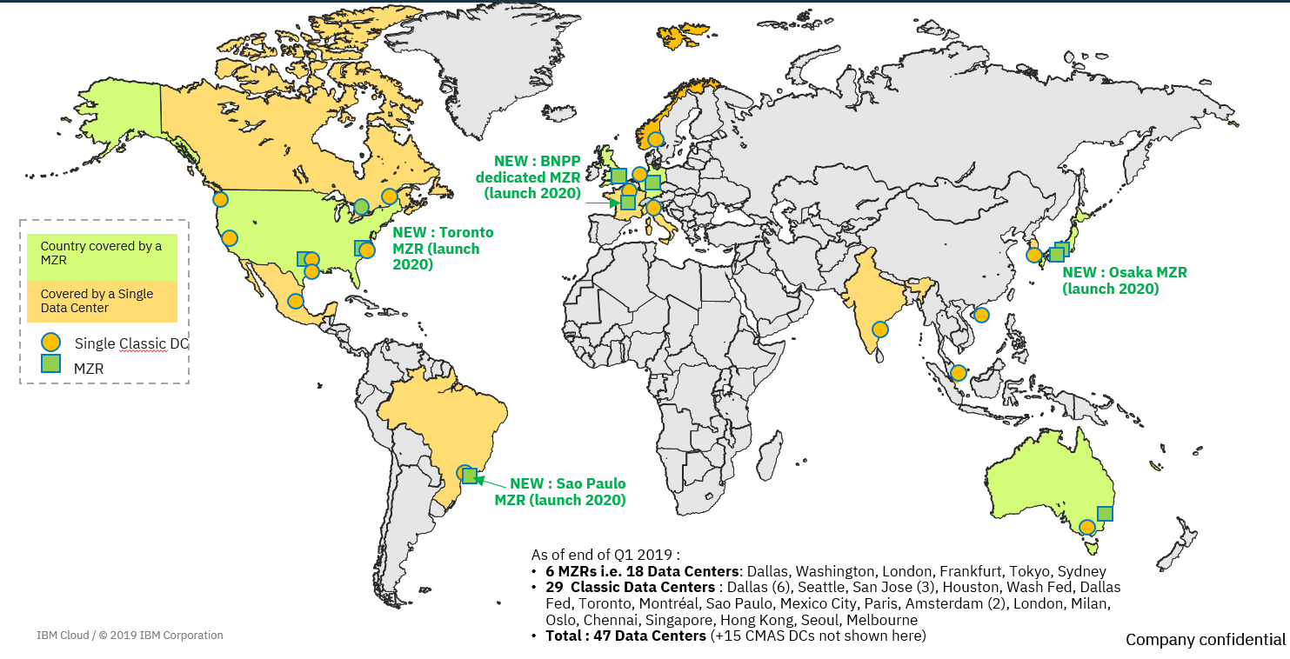
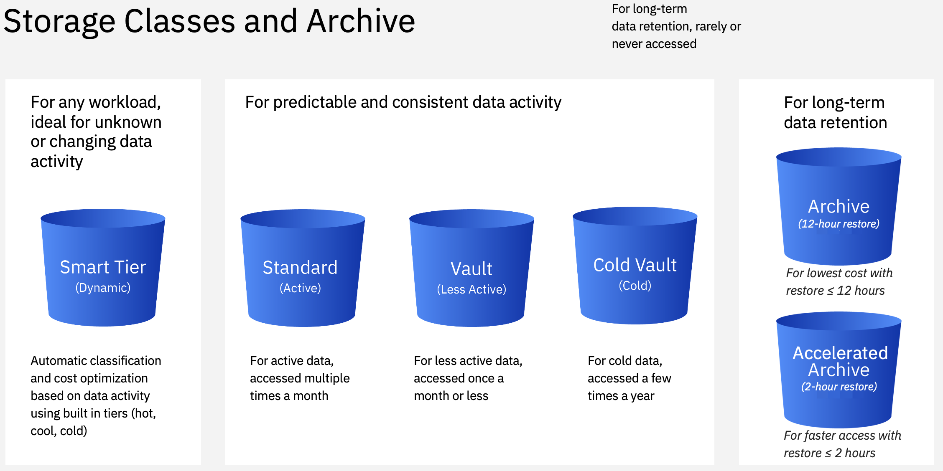
Avantages du Stockage Objet IBM Cloud
Sécurité la plus élevée du marché
  Conformité la plus élevée de cryptage des données du marché
Le stockage objet IBM Cloud
  Eco-système important dans le cloud
  Expérience avérée dans le domaine du stockage à l'échelle de l'exaoctet pour la sauvegarde des appareils mobiles.
  Haute performance pour répondre aux besoins de >1M d'utilisateurs simultanés avec un débit moyen jusqu’à 2 Gbps par session
  Possibilité de disposer d’un espace de stockage illimité avec paiement à l’usage
  Support API S3, le plus standard du marché, compatibilité avec des centaines de produits du marché
Résilience multi niveau
    Par zone, par region et inter-region
    SLA 99,95% le plus haut du marché
    Durabilité inégalée : 99,999… (mesurée aujourd’hui à 29 fois 9 après la virgule)
    Possibilité d’avoir des données Immuables
Coût
  Modèle de prix très souple
  Prix le plus bas du marché en mode d’archivage équivalent au prix d’une bande magnétique

Slide 2
Why Shift to IBM Public Cloud?
Watson API’s
  Only leader for AI Powered Conversational Computing
  Best in Enterprise APIs
  You own the insights
Blockchain
Parity with AWS
  200+ services available in the IBM Public Cloud catalog
  Global Reach – IBM Cloud’s footprint includes 10 MZRs and 29 Classic Data Centers
Security leadership
  Highest industry compliance for data encryption
  IBM offers the most secure, highest level of Data Confidentiality in the industry. With Hyper Protect DBaaS and Cloud Object Storage, no unauthorized users can access your data - it's not technically possible.
  Crypto technology: Ours has never been broken, and it’s an integrated solution that our competitors do not offer
Open innovation
  Build once, deploy anywhere with OpenShift
  Kubernetes on IBM Cloud supports 1k+ enterprise clients, 16k+ clusters in prod
  Major contributor to Cloud Native Open Source Projects like Razee, Istio, Knative, and Eirini
Cloud Object Storage
  Proven experience at exabyte scale storage for mobile device backup
  High performance to meets the need of >1M concurrent users
  Ability to have a limitless bucket

Slide 3
Why IBM Cloud Object Storage?
Global footprint includes multi-zone regions (MZR)
Online and archive tiers of storage available
Immediate consistency across the MZR implementations compares to other multi-site solutions provide eventual consistency
Security
  Encrypted at rest and in flight
  Keep your own key with hyper protect integration
  BYOK encryption options, key rotation and notifications
  Identity management and permissions
The object storage technology (Cleversafe) is available in the IBM Public Cloud, on-prem, hybrid solutions or managed solutions and is recognized as the #1 leading solution for distributed file systems and object storage (Gartner 2019)

Slide 4
Why IBM Cloud Object Storage?
The ability to expand a bucket limitlessly – IBM currently has several clients with very large buckets, including buckets at >200 PiB usable
Infinitely scalable technology meets or exceeds performance needs
  Large objects (> 4 MB): PUT ~2s, GET : ~350 ms or better
  Small objects (< 4 MB): PUT : ~100 ms , GET: ~40 ms or better
Industry leading durability and availability
  Durability: published designed for 99.999999999% (internal design exceeds 31 9’s-20 more than our competitors)
  Availability: 99.95+ % (based on external measurement)
Leverage an S3 compatible API (minimizes switching costs)
Option for Cross Region resiliency (Significant Savings vs Competition)
Notes:
99.95% availability is operational, this is not our SLA.
Durability: published designed for 99.999999999% in our SLA with clients but internally we are designed for 31 9’s.

Slide 5
“Cloud” Object Storage Capabilities Comparison
Object Storage Capability | IBM Cloud Object Storage | Amazon S3 | MS Azure Blob Storage | Google Cloud Storage
Single-region availability & data durability | ✔ | ✔ | ✔ | ✔
Inherent multi-region availability & durability | ✔ | ✖ |  | ✔
Immediate data consistency for both single-region & multi-region services | ✔ | ✖ | ✖ | ✖
Non-shared single-tenant off-premises object storage services IBM DEDICATED | ✔ | ✖ | ✖ | ✖
On-premises object storage systems | ✔ | ✖ | ✔ | ✖
Hybrid object storage deployments | ✔ | ✖ | ✔ | ✖
Support for multiple APIs & open standards
Limited Access.
R/W Primary Site
ONLY
S3 API
S3 API
Azure API
Google HTTP API, S3 API
IBM Cloud Object Storage Competitive Wiki at: http://ibm.biz/Bd4nKY

Slide 6
IBM Cloud Object Storage Key SLA’s
 | IBM Cloud Object Storage | AWS | Azure
Offering | Standard (Frequent access) | S3 Standard | Blob Hot
Availability SLA (Actual SLA w/ credits, Not Design Target) | Up to 99.95% | Up to 99.9% | Up to 99.99% (Hot reads only for RA-GRS), Up to 99.9% for writes in all other
Data Durability* | Designed for 99.99999999999999999999999999999% (31 9s) | Designed to provide 99.999999999% (11 9's) | Designed to provide 11 9s in LRS, 16 9s in GRS
Data Resiliency | MZR, Single Data Center or Cross-Region | MZR or Single Data Center | MZR or Single Data center
Immutability | MZR, Cross Region | MZR | No
Time to First Byte | Milliseconds | Milliseconds | Milliseconds
Data Consistency | Immediate in single region and cross region | Eventual | “Strong” in single region
Security | Encryption at rest and in motion, IAM, Key Protect, Hyper Protect Crypto Services, COS Firewall (IP Whitelisting), Immutability | Encryption at rest and in motion, IAM, Key Protect, IP Whitelisting, Immutability | Storage firewall, encryption at rest and in motion, Key Vault, IAM, Immutability
Scalability | Unlimited per bucket | Unknown | Account and container limit: 2 PiB US/Europe, 500TB all other regions, Object size limit: 4.75TiB

Slide 7




IBM Cloud: The most available public cloud storage for business
Standard (Hot) | 10% credit if < 99.95%✓ 25% credit if < 99.90% 100% credit if < 95.0% (1H 2020) | 10% credit if < 99.9% 25% credit if < 99.0% | 10% credit if < 99.9% 25% credit if < 99.0% | 10% credit if < 99.9% 25% credit if < 99.0%
Smart Tier | 10% credit if < 99.95%✓ 25% credit if < 99.90% 100% credit if < 95.0% (1H 2020) | No Flex Class. ✘ | No Flex Class ✘ | No Flex Class ✘
Vault (Cool) | 10% credit if < 99.5%✓ 25% credit if < 99.0% 100% credit if < 95.0% (1H 2020) | 10% credit if < 99.0% 25% credit if < 98.0% | 10% credit is < 99.0% 25% credit if < 98.0% | 10% credit if < 99.0% 25% credit if < 98.0%
Cold Vault (Cold) | 10% credit if < 99.0%✓ 25% credit if < 98.0% 100% credit if < 95.0% (1H 2020) | No disk based offering ✘ | No disk based offering ✘ | 10% credit if < 99.0%✓ 25% credit if < 98.0%
Archive | 99.9% | Glacier – 99.9% | Azure Blob Archive – 99.9% | Archive – No SLA
2020 IBM Corporation
7
Notes:
See service level details here: https://www-03.ibm.com/software/sla/sladb.nsf/sla/bm

Slide 8

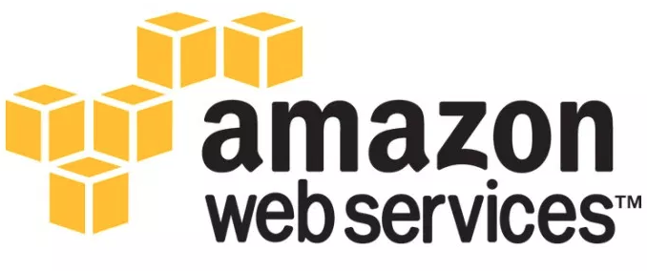
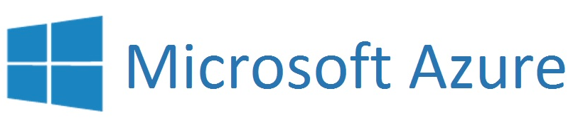

Cloud Object Storage - Competitive Pricing and Metrics
1
IBM (COS) |  |  |  |  |  |  |  |  |  |  |  |  |  |  | Google
Tier | Store ($/GB/ month) | Retrieve/ Restore ($/GB) | Class A/B ops ($ per 10,000 Requests) | BW ($ per GB) | Tier | Store ($/GB/ month) | Retrieve/ Restore ($/GB) | Class A/B ops ($ per 10,000 Requests) | BW ($ per GB) | Tier | Store ($/GB/ month) | Retrieve/ Restore ($/GB) | Class A/B ops ($ per 10,000 Requests) | BW ($ per GB) | Tier | Store ($/GB/ month) | Retrieve/ Restore ($/GB) | Class A/B ops ($ per 10,000 Requests) | BW ($ per GB)
Standard | $0.022 | - | $0.05/ $0.004 | $0.090 - $0.050 (Tiered) | Standard | $0.023 | - | $0.05/ $0.004 | $0.090 - $0.050 (Tiered) | Block Blob Hot | $0.0184 | - | $0.05/ $0.004 | 0.087 - Tiered | GCS (Regional) | $0.02 | - | $0.05/ $0.004 | $0.12 - $0.08 (Tiered)
Smart Tier | Hot: $0.021 Cool: $0.012 Cold: $0.0075 | - | $0.05/ $0.05 | $0.090 - $0.050 (Tiered) | Intelligent -Tiering | $0.023 / $0.0125 ² (</≥30 days) | - | $0.05/ $0.004 | $0.090 - $0.050 (Tiered)
Vault | $0.012 | $0.01 | $0.1/ $0.01 | $0.090 - $0.050 (Tiered) | Standard-IA | $0.0125 | $0.01 | $0.1/ $0.01 | $0.090 - $0.050 (Tiered) | Block Blob Cool | $0.01 | $0.01 | $0.1/ $0.01 | 0.087 - Tiered | Nearline | $0.01 | $0.01 | $0.1/ $0.01 | $0.12 - $0.08 (Tiered)
Cold Vault INLINE | $0.006 | $0.05 IMMED | $0.25/ $0.025 | $0.090 - $0.050 (Tiered) |  |  |  |  |  |  |  |  |  |  | Coldline | $0.004 | $0.02 | $0.1/ $0.05 | $0.12 - $0.08 (Tiered)
 |  |  |  |  | Glacier – Expedited | $0.004 | $0.03 ³ (1-5 min) | $0.05 per 1,000 requests | $0.090 - $0.050 (Tiered)
Archive – Accelerated Restore OFFLINE | $0.00099 | $0.04 (<2 hrs) | - | $0.090 - $0.050 (Tiered) | Glacier – Standard | $0.004 | $0.01 (3-5 hrs) | $0.05 per 1,000 requests | $0.090 - $0.050 (Tiered) | Block Blob Archive | $0.00099 | $0.05 (<1 hr) | $0.1/ $25 | 0.087 - Tiered | Archive | $0.0012 | $0.05 (ms) | $0.5/ $0.5 | $0.12 - $0.08 (Tiered)
Archive – Regular Restore | $0.00099 | $0.02 (<12 hrs) | -
Archive – Regular Restore OFFLINE | $0.00099 | $0.02 (<12 hrs) | - |  | Glacier – Deep Archive | $ 0.00099 | $0.0025 (5-12 hrs) |  |  |  | $0.00099 | $0.02 (<15 hrs) | $0.1/$5 | 0.087 - Tiered
¹ Pricing comparison based on US – Regional offering
² Monitoring and Automation, all storage/month = $0.0025 per 1,000 objects
³ Additional On-Demand charge: $0.01 per request

Slide 9
Public Cloud Archive Pricing Comparison –
Industry’s lowest cost public cloud storage options
✓
= On Par or Better
 | AWS | Azure | IBM Cloud | Google
Offering | Glacier Deep Archive | Storage Blobs Archive | COS Archive | Archive
Storage per GB | $0.00099 | $0.001 (LRS single DC) $0.003 (multi region 2 DC) +$0.02/GB data transfer | $0.00099 MZR Cross region TBD | $0.0012+ MZR $0.004+ Multi Region + $0.01+/GB data xfer
Requests (per 1k) | PUTs, etc $0.05 GETs, etc $0.0004 | Writes $1 ($10 per 10k) | None | PUTs, etc $0.05 GETs, etc $0.05
Data Retrieval Requests | Standard = $0.10 per 1k Bulk = $0.025 per 1k | $5 per 10k $25 per 10k High Priority | None | $0.50 per 10k
Lifecycle Transition Requests (per 1k) | $0.05 | None | None | $0.05 ($0.50 per 10k)
Restores | $0.02/GB < 12 hours | $0.02/GB < 15 hrs $0.05/GB < ~1 hrs | $0.02/GB < 12 hrs $0.04/GB < 2 hrs | $0.05/GB in milliseconds
Availability SLA | 99.9% | 99.9% | 99.95% | None
Minimum Duration | 180 days | 180 days | 90 days | 365 days
✓
✓
✓
✓
✓
✓

Slide 10
IBM COS Cloud Competitive Mapping – Resiliency
 | IBM | AWS | Azure | Google
Resiliency | Single Data Center – Specific regions globally where IBM does not have an availability zone deployed. Otherwise position Regional resiliency. | N/A Expect Region positioning | Locally Redundant Storage (LRS) – 3 synchronous copies of data within a single datacenter. | N/A Expect Regional Storage positioning
 | Regional – Data deployed in multiple IBM Cloud facilities within a single geographic zone, protects data from common component failures and power outages. | Region – Data deployed in single Region with minimum of two Availability Zones chosen by Customer or automatically selected by AWS | Zone Redundant Storage (ZRS) - Stores 3 copies of data across 2-3 datacenters within or across regions. Block blobs only. R/W in primary region only. Cannot be converted to LRS, GRS, or RA-GRS | Regional Storage - Storage frequently accessed in the same geographic Region
 | Cross-Region – Data deployed in IBM Cloud data centers across three or more geographic zones, helping ensure business continuity and workload data accessibility via multiple regions. All regions R/W with immediate cross-region consistency. | Cross-Region Replication (CRR) – Customer defined replication targets of one or more additional Regions. Customer pays inter-region data transfer for the replicated copy of data. Limited no Glacier. | Geographically Redundant Storage (GRS) - Same as LRS, plus maintains 6 asynchronous copies – 3x primary region plus 3x secondary region 100’s of miles away. R/W primary region only. Read-Only in secondary region. | Multi-Regional Storage - geo-redundant in at least two regions separated by at least 100 miles. Storing data that is frequently accessed. May be Nearline or Coldline storage. Replication between select regions will incur data transfer charge.
 | Cross-Region | Cross-Region Replication | Read-access Geographically Redundant Storage (RA-GRS) - Same as GRS, plus read access to the secondary datacenter. | Multi-Regional Storage

